Slide 1
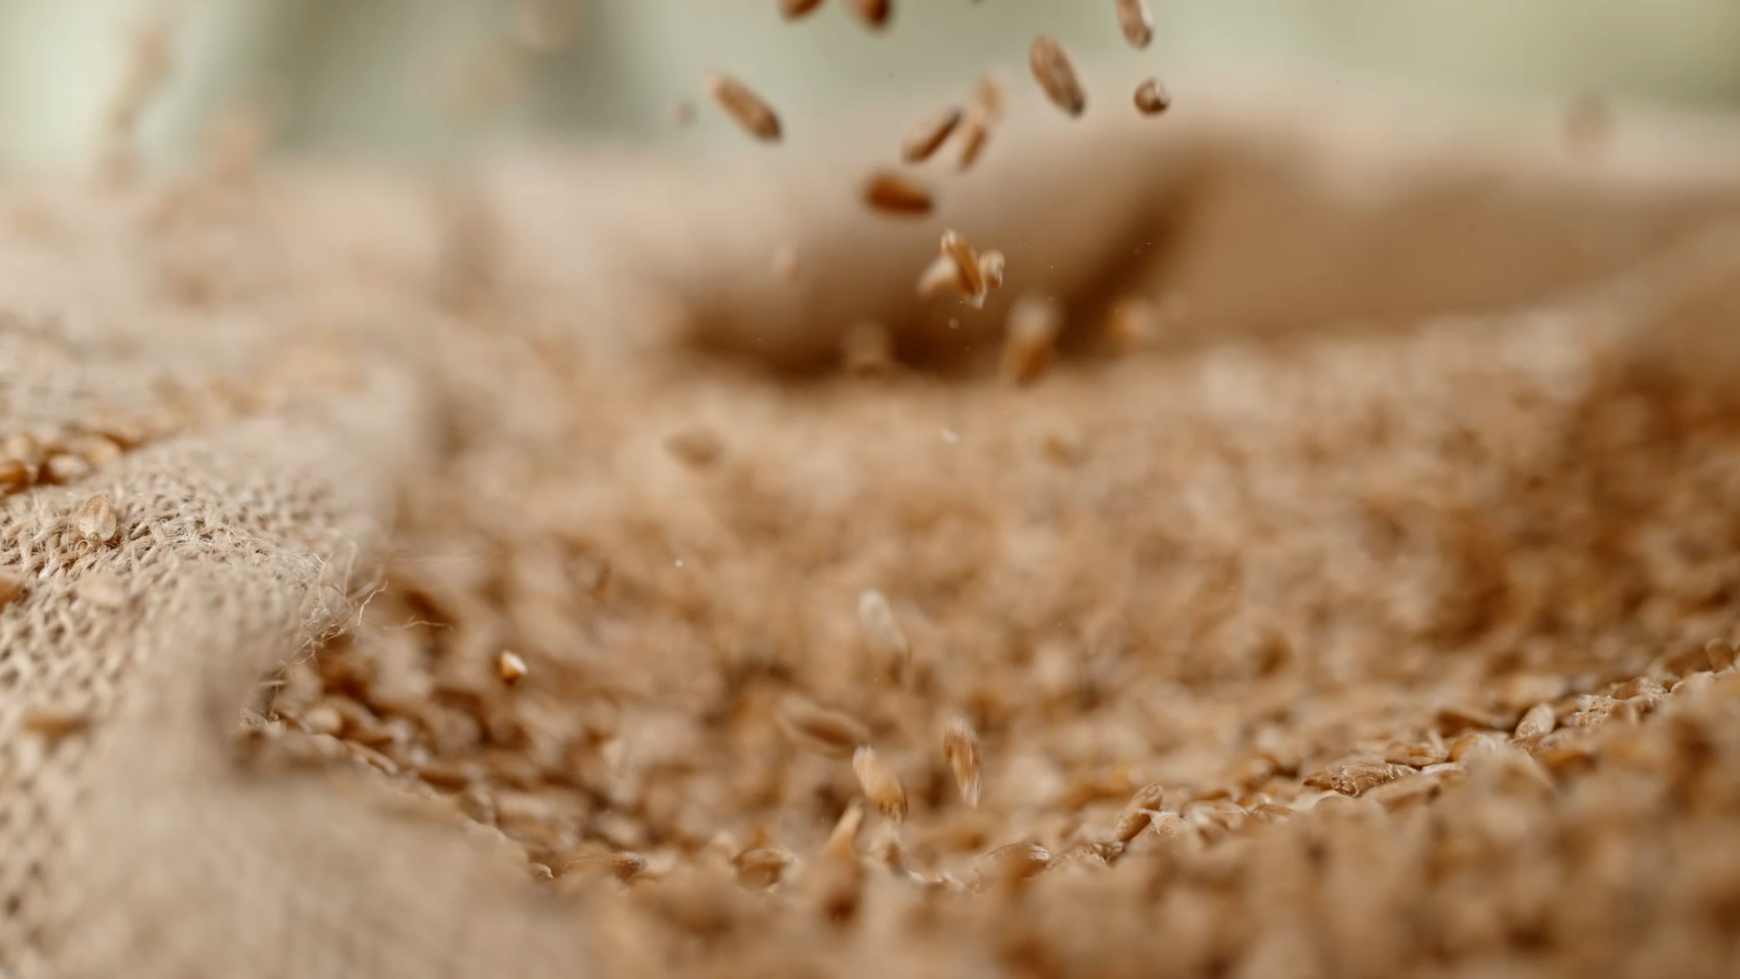
Rice Image Classification

Slide 2
About the Project
The project aims to leverage Bigdata framework in order to solve Image classification problem. The dataset used for this process is the Rice dataset. The dataset has 5 categories and each category has around 15,000 sample images. The dataset also has 12 morphological, 4 shape, and 90 color features. This data focuses on varieties such as Arborio, Basmati, Ipsala, Jasmine, and Karacadag rice.
Hadoop ecosystem was designed in order to read data from HDFS into Spark where the images are processed and result are stored. For this project we have used PySpark (Spark extension that allows python integration). The data has been trained using CNN model.

Slide 3
Hadoop Ecosystem
The Hadoop ecosystem is a collection of open-source software frameworks and tools designed to process and analyze large datasets in a distributed computing environment.
Two key components of the Hadoop ecosystem are the Hadoop Distributed File System (HDFS) and PySpark
HDFS follows a master-slave architecture, where the NameNode serves as the master and manages the file system's metadata, while the DataNodes act as slaves and store the actual data blocks.
PySpark, is the Python library for Apache Spark, an open-source, cluster-computing framework designed for big data processing and analytics.
When using HDFS and PySpark together, we can leverage the power of distributed storage and processing.
By combining HDFS and PySpark, we can build data pipelines that read data from HDFS, process it using Spark's powerful distributed computing capabilities, and store the results back in HDFS or any other supported data storage system.

Slide 4
Setting up the Hadoop ecosystem
HDFS
(Storage System)
PySpark
(Image Processing)
While installing the system it is very important to take care of the version of Hadoop, Spark, Python, and Keras. Make sure that you have a seamless compatibility between them.
In this project we have used the below configuration.
Hadoop version 3.2.0
Spark version 3.2.4
Python version 3.9
TensorFlow version 2.12.0
Keras version 2.12.0

Slide 5
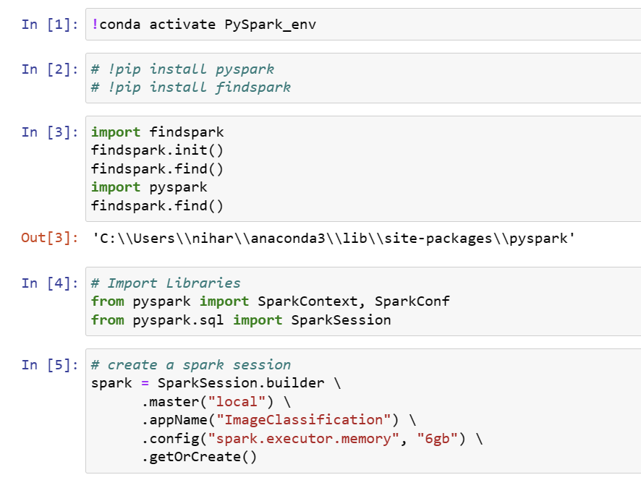
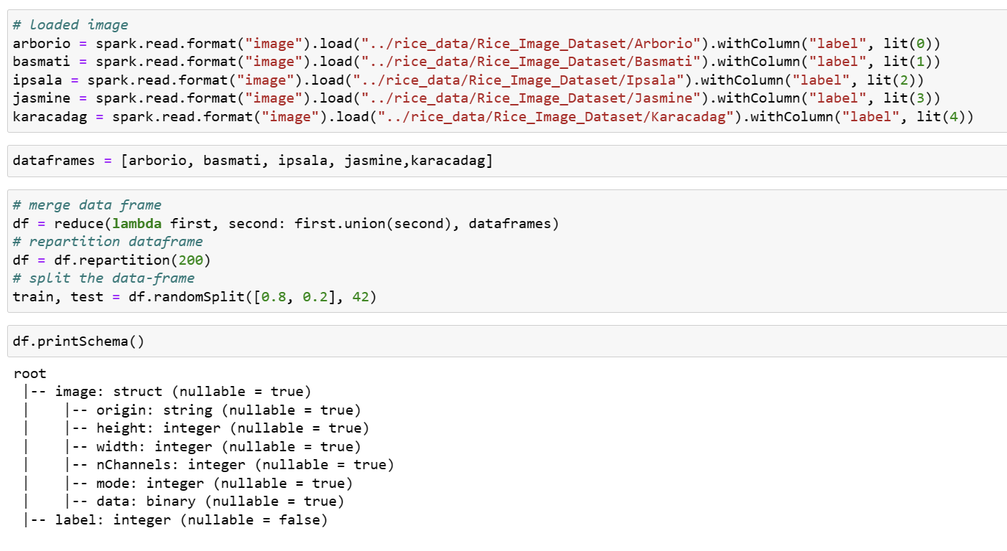
Create Spark Instance and load Data

Slide 6
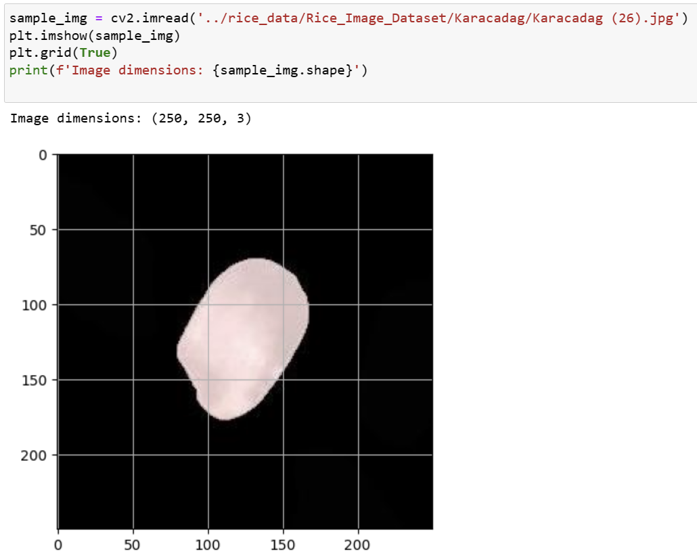
Sample Data

Slide 7
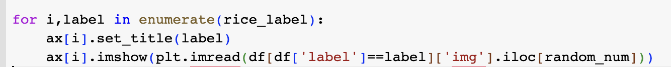
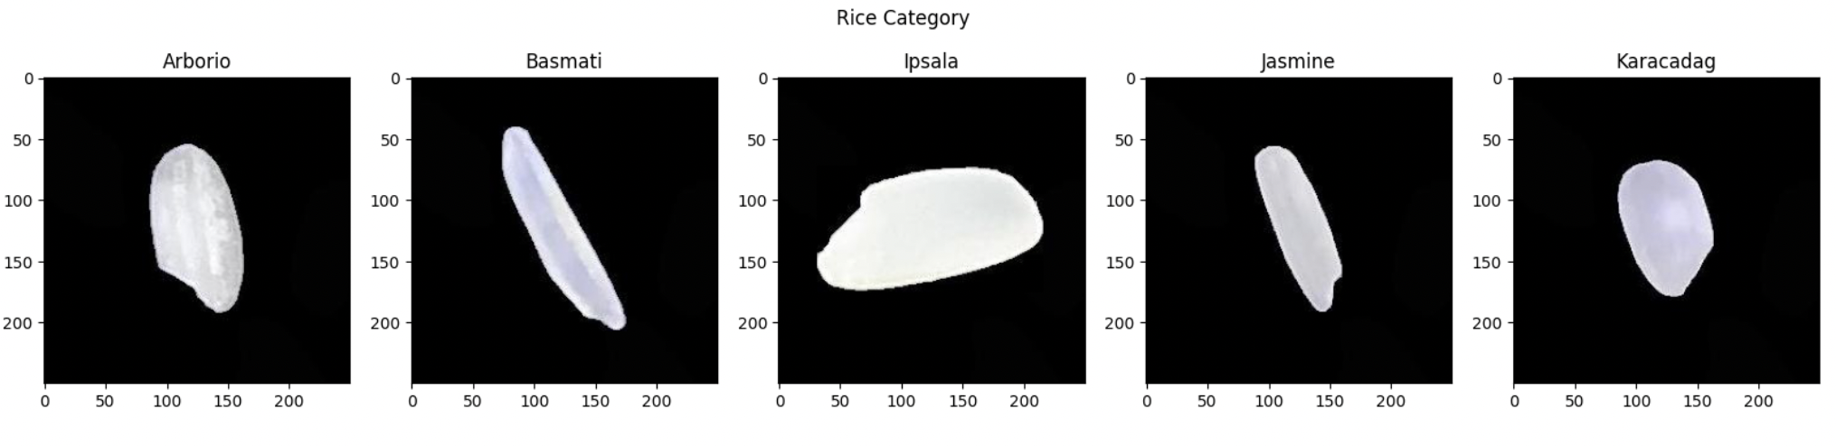
Data preprocessing
Create a subplot with the number of columns equal to the number of category
Loop through rice_label to show 1 image of each rice label
plt.imread is used to read an image from a file into an array
imshow is used to print an image using an image array as an input

Slide 8
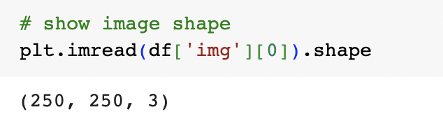
Data preprocessing
Image shape is crucial in computer vision programming since a deep learning model will be defined the desired image size.
Before inputting an image into the model, we have to resize an image to match the desired size.
.shape is used with an image array to know the image size.
The result is (250, 250, 3).

Slide 9
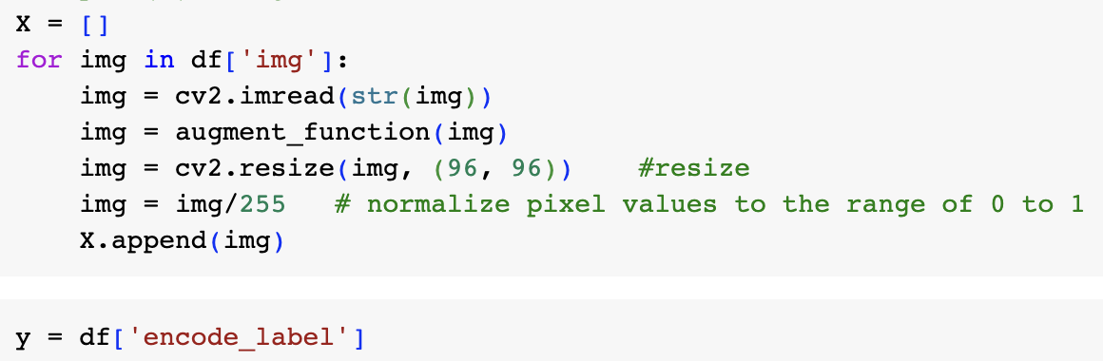
Data preprocessing
Before an image is inputted for model training, it must be converted to an array with a specific size for the model and scaled to have a value between 0 and 1.
Output (y): encoded label of each image

Slide 10
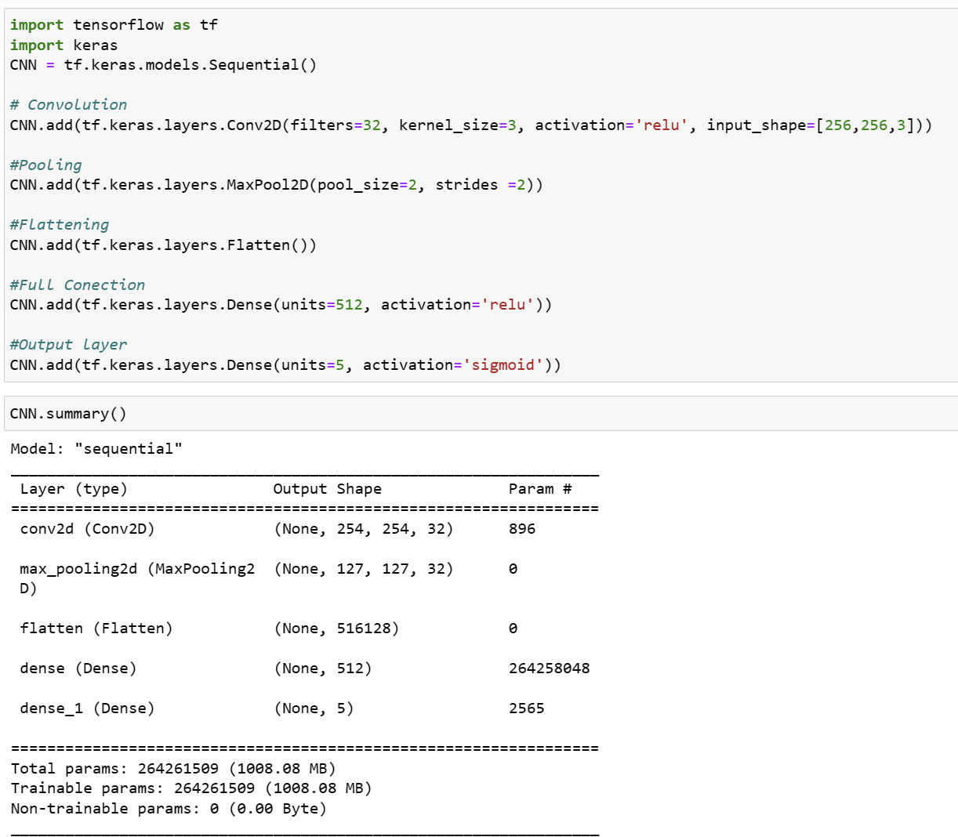
Modeling-CNN

Slide 11
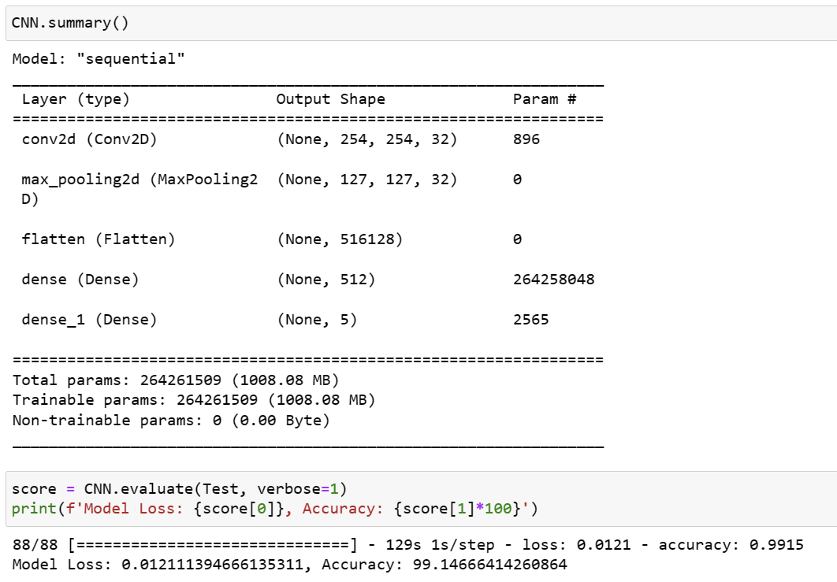
Fine-tuning the model
We trained the model for multiple epochs
Model was tuned based on the Accuracy
The best result is as shown in the image.

Slide 12
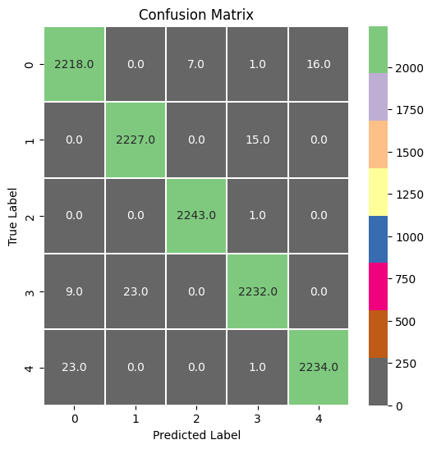
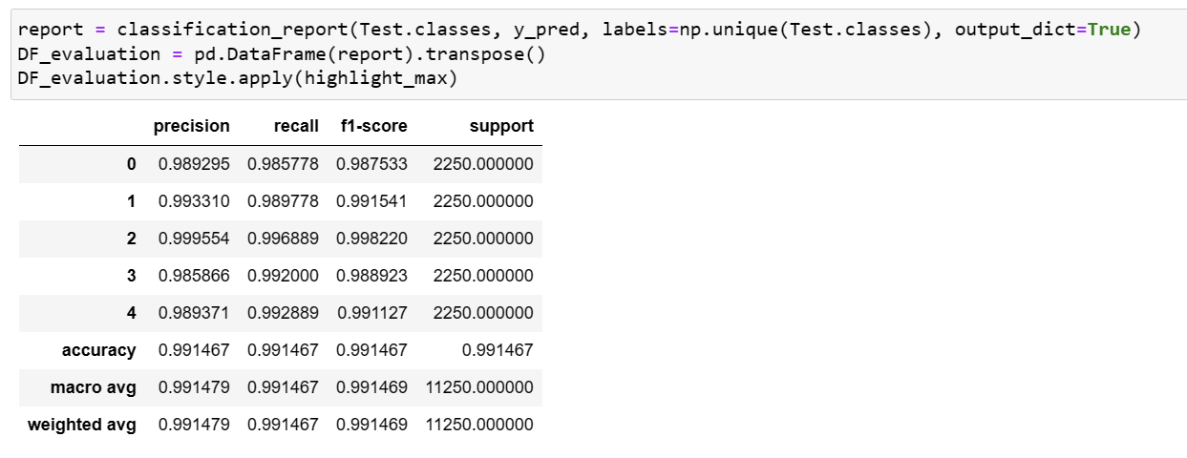
Model Evaluation

Slide 13
Thank you

